Slide 1
Alpha activity related to SNR 50
the general function of alpha oscillations in “gating by inhibition.”
In this framework, high-amplitude alpha oscillations are suited to gate or suppress spontaneous or task-irrelevant higher frequency (i.e., Gamma) oscillations in neural networks; similarly, a relative “silencing” of alpha oscillations takes away this inhibitory gating and allows for Gamma oscillations to occur.
Increasing alpha power indicates high demands on attention, which can be triggered by less acoustic detail of target speech as well as by more acoustic detail of distractor speech
Enhanced alpha oscillations (8–13 Hz) during retention of items in working memory are often interpreted to reflect increased demands on storage and inhibition.
In sensory regions, alpha-like oscillations are the dominant rhythm at rest and decreases in power (desynchronizes) when actively engaged in processing or even anticipating a stimulus
the level of alpha activity may be viewed as an indicator at which state the respective cortical tissue is along a continuum marked by excitation and inhibition: low levels of alpha reflect a state of excitation, whereas high levels of alpha a state of inhibition
Tinnitus may relate to reduced background alpha
transient decrease of alpha-like activity in the 6.5–9 Hz band following sound onset
This would also imply to interpret the observed alpha modulations as relative increases in alpha power for more degraded stimuli. Foxe et al. (1998) report a 10-Hz parieto-occipital enhancement that was stronger for selective attention to auditory cues, which is in line with a role of enhanced alpha oscillations in inhibiting task-irrelevant information – a case we observe for more degraded speech stimuli.
Suppression of alpha and beta oscillations is often related to the engagement of task‐relevant brain areas, whereas an increase reflects functional inhibition or disengagement (Jensen & Mazaheri, 2010; Klimesch, Sauseng, & Hanslmayr, 2007; Pfurtscheller & Lopes da Silva, 1999). Increases in gamma activity have been proposed to reflect enhanced neuronal computation
Studies on unimodal auditory degraded speech comprehension have demonstrated that parietal alpha power is enhanced when speech is degraded

Slide 2
Alpha activity related to SNR 50
Methods
Participants (n=38): Mean age=65 (31-78). Mild to moderate hearing loss. Hearing aid users
Measures:
Alpha power (7.5-12.5 hz) in occipital brain regions
Signal to noise ratio (SNR) threshold at 50% correct (SNR-50)
Subjective measures of hearing loss
EEG
64-channel EEG monitored using Neuroscan
Reference – Cz. Ground – Afz
Eyes alternate between open and closed conditions lasting 2 minutes each. 3 trials. 12 minutes total
EEG data analyzed in Matlab using Fieldtrip
Data bandpass filtered between .5 and 50 hz
Independent component analysis removed components related to signal, eye movement, and cardiac noise
FFT analysis run using Hanning window
Alpha power calculated between 7.5 and 12.5 hz
Alpha peak selected between 7.5 and 12.5 hz. Peak +/- 2hz are selected as a 4 hz window.
Alpha peak power is calculated around 4 hz window

Slide 3
SNR study
MoCA – Montreal Cognitive Assessment
Test Box Measures
ANSI
DIR (SNR = 3)
DNR (AC 70 dB)
ANL (Unaided) – Acceptable Noise Level
HINT/PPT (Unaided)- Hearing In Noise Test
Real Ear Measures
MLST & Listening Effort Estimates – Multimodal Lexical Sentence Test
APHAB – Abbreviated Profile of Hearing Aid Benefit
HHIE/HHIA – Hearing Handicap Inventory for Elderly
DOSO – Development of the Device-Oriented Subjective Outcome SADL – Satisfaction with Amplification in Daily Life IOI-HA – International Outcome Inventory for Hearing Aids
SSQ12 – Speech Spatial and Qualities of Hearing
ALDQ
LESQ
NEO-FFI
Reading Span
Word Span

Slide 4
Alpha power during ERP (0-1.25 seconds post-stim)
Occipital channels (O1, O2, OZ)
lm(formula = alpha_peak_ERP_occ ~ alpha_power_peak_ratio + snr50_psycho +
aud + aphab_unaided_bn + aphab_unaided_rv + aphab_aided_ec,
data = all_data)
Residuals:
Min 1Q Median 3Q Max
-1.39946 -0.30176 0.05417 0.25763 1.96915
Coefficients:
Estimate Std. Error t value Pr(>|t|)
(Intercept) -0.769103 0.845549 -0.910 0.37080
alpha_power_peak_ratio 1.077239 0.526980 2.044 0.05044 .
snr50_psycho -0.161904 0.053808 -3.009 0.00549 **
aud 0.051091 0.018852 2.710 0.01135 *
aphab_unaided_bn 0.014189 0.010014 1.417 0.16753
aphab_unaided_rv -0.017753 0.009225 -1.925 0.06450 .
aphab_aided_ec 0.040025 0.016998 2.355 0.02578 *
---
Signif. codes: 0 ‘***’ 0.001 ‘**’ 0.01 ‘*’ 0.05 ‘.’ 0.1 ‘ ’ 1
Residual standard error: 0.7202 on 28 degrees of freedom
Multiple R-squared: 0.4102, Adjusted R-squared: 0.2838
F-statistic: 3.246 on 6 and 28 DF, p-value: 0.01504
APHAB
EC: Ease of communication
BN: Background Noise
RV: Reverberation
AV: Aversiveness scale
alpha_ERP[,c(9,10,31)]))

Slide 5
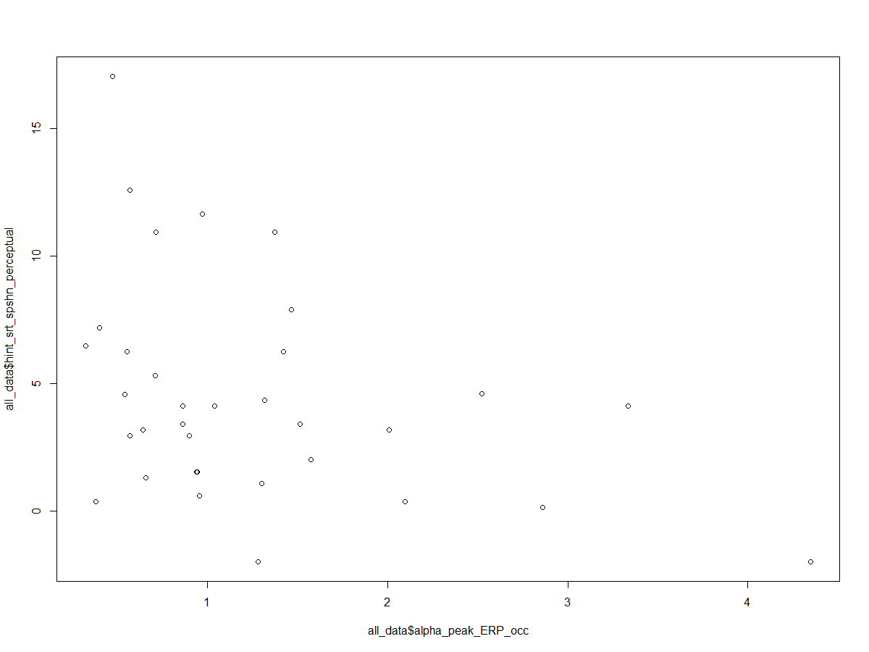
Alpha power during ERP
Occipital and Parietal channels (P4,P3,O2,O1,P8,P7,Pz,CB1,CB2,Oz,Iz,PO4,PO3,P1,Poz,P2,P6,P5
lm(formula = alpha_peak_ERP_occ ~ alpha_power_peak_ratio + aud +
aphab_unaided_bn + aphab_unaided_rv + aphab_unaided_av +
aphab_aided_ec + hint_srt_spshn_perceptual, data = all_data)
Residuals:
Min 1Q Median 3Q Max
-1.3523 -0.3902 -0.1119 0.3703 1.6277
Coefficients:
Estimate Std. Error t value Pr(>|t|)
(Intercept) -0.525441 0.893271 -0.588 0.56146
alpha_power_peak_ratio 0.849402 0.554945 1.531 0.13794
aud 0.039204 0.018523 2.116 0.04404 *
aphab_unaided_bn 0.014788 0.009850 1.501 0.14532
aphab_unaided_rv -0.015529 0.009450 -1.643 0.11238
aphab_unaided_av -0.009472 0.006693 -1.415 0.16887
aphab_aided_ec 0.047954 0.017744 2.703 0.01196 *
hint_srt_spshn_perceptual -0.139247 0.042517 -3.275 0.00299 **
---
Signif. codes: 0 ‘***’ 0.001 ‘**’ 0.01 ‘*’ 0.05 ‘.’ 0.1 ‘ ’ 1
Residual standard error: 0.7248 on 26 degrees of freedom
(1 observation deleted due to missingness)
Multiple R-squared: 0.4885, Adjusted R-squared: 0.3508
F-statistic: 3.547 on 7 and 26 DF, p-value: 0.008283
(alpha_ERP[,c(7,8,9,10,15,16,17,25,26,31,32,33,34,48,49,50,51,53)

Slide 8
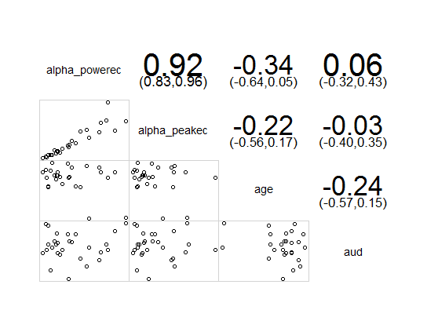
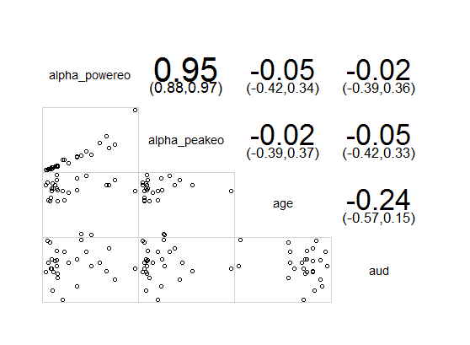
Alphapower vs age and audibility
Eyes Closed
Eyes Open

Slide 9
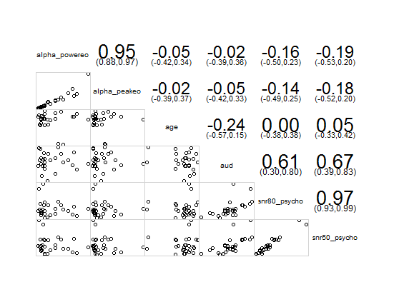

Alpha power vs SNR 50 and SNR 80

Slide 10
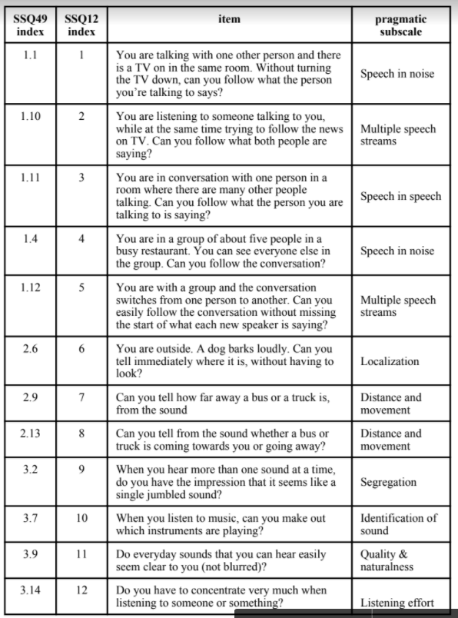
SSQ categorized
lm(formula = alpha_power_peak_ratio ~ SSQ2, data = all_data)
Residuals:
Min 1Q Median 3Q Max
-0.39029 -0.13188 0.01583 0.12879 0.49161
Coefficients:
Estimate Std. Error t value Pr(>|t|)
(Intercept) 0.761527 0.108139 7.042 3.95e-08 ***
SSQ2 -0.003667 0.001652 -2.220 0.0332 * ---
Signif. codes: 0 ‘***’ 0.001 ‘**’ 0.01 ‘*’ 0.05 ‘.’ 0.1 ‘ ’ 1 Residual standard error: 0.2153 on 34 degrees of freedom Multiple R-squared: 0.1266, Adjusted R-squared: 0.1009 F-statistic: 4.93 on 1 and 34 DF, p-value: 0.03316
Notes:
resting state may relate to temporal processing, and relate to sound localization. ERP design for temporal processing.

Slide 11
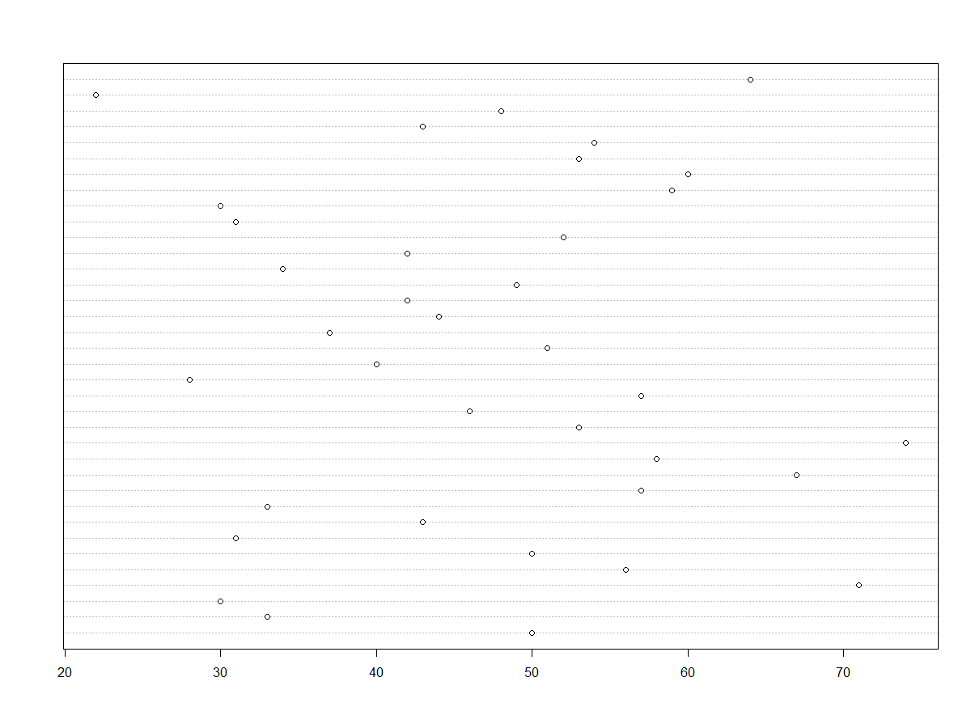
ALDQ Demand
lm(formula = aldq_demand ~ alpha_power_peak_ratio + alpha_power_peakec + alpha_power_peakeo + snr80_psycho + snr50_psycho + SSQ1 + SSQ2 + SSQ3 + aphab_unaided_ec + aphab_unaided_bn + aphab_unaided_rv + aphab_unaided_av + aphab_aided_ec + aphab_aided_bn + aphab_aided_rv + aphab_aided_av, data = all_data)
Residuals:
Coefficients:
Estimate Std. Error t value Pr(>|t|) (Intercept) 56.417056 33.800550 1.669 0.113 alpha_power_peak_ratio -5.055842 30.783531 -0.164 0.871 alpha_power_peakec 0.647862 1.340339 0.483 0.635 alpha_power_peakeo -1.297697 2.879125 -0.451 0.658 snr80_psycho 1.161353 2.022619 0.574 0.573 snr50_psycho -3.306467 3.013500 -1.097 0.288
SSQ1 -0.176235 0.214662 -0.821 0.423
SSQ2 -0.004642 0.190793 -0.024 0.981
SSQ3 0.184676 0.274937 0.672 0.511 aphab_unaided_ec 0.163848 0.254763 0.643 0.529 aphab_unaided_bn -0.301510 0.315075 -0.957 0.352 aphab_unaided_rv 0.157114 0.214812 0.731 0.474 aphab_unaided_av -0.148152 0.231992 -0.639 0.532 aphab_aided_ec 0.233544 0.684207 0.341 0.737 aphab_aided_bn 0.032432 0.267178 0.121 0.905 aphab_aided_rv -0.165626 0.267673 -0.619 0.544 aphab_aided_av 0.065408 0.181108 0.361 0.722
Residual standard error: 14.83 on 17 degrees of freedom (2 observations deleted due to missingness) Multiple R-squared: 0.318, Adjusted R-squared: -0.324 F-statistic: 0.4953 on 16 and 17 DF, p-value: 0.9164

Slide 12
Next steps
Classify successful and unsuccessful users by ALDQ demand
cluster, K-means
Logistic modeling of alpha, SNR, and subjective measures
Complete ICA of alpha power during sound stimulus (ERP)
Model alpha power during ERP with other predictor variables

